Slide 1


IGNITE
Pitch Deck
Milestone 1

Slide 2

Who we are
Name of your Venture: AUTO FIX AI –REVOLUTIONIZING AUTOMOTIVE REPAIR
Place your venture logo here
Why ?
Explain why do you want to pursue this Business Idea.
We aim to solve common challenges faced by the vehicle owners such as lack of knowledge ,difficulty in finding reliable mechanics ,unexpected repair costs ,and delay in service .We aim to make car repair simple and transparent and accessible. Our goal to empower users with smart automotive support.
What ?
Provide a brief on what does your venture do.
AUTO FIX AI is an intelligent app that helps diagnose vehicle issues instantly. It provides solutions and connects users
With nearby verified garages. It acts as a digital assistant for car maintenance and repair.
How ?
Explain how your venture solves the problem and make its revenue.
The app use AI and smart technology to analyse problems and suggest solutions .It integrates GPS to locate garages and guide users. Revenue comes from commissions ,subscription, and advertisements.

Slide 3

Problem/Opportunity
Place your logo here
CONTEXT When does the problem occur? "The problem occurs in three situations — when a warning light appears and the owner doesn't understand it, when the car makes strange sounds or behaves abnormally, and when the car breaks down in an unknown location far from help. In all three cases, the owner feels confused, stressed, and helpless — and that is exactly the gap Auto Fix AI fills." | PROBLEM What is the root cause of the problem? The root cause of the problem are Lack of car knowledge, No simple diagnostic tool for normal people, No trusted transparent system. | ALTERNATIVES What do customers do now to ﬁx the problem? Customers now usually visit a mechanic ,call roadside help, or use towing services to fix the problem. Some also search in google, watch on YouTube videos, or ask others for devices.
CUSTOMERS Who has the problem most often? The problem often faced by the –Non technical car users -People in remote areas and semi-urban areas -Busy working professionals | EMOTIONAL IMPACT How does the customer feel? Customers often feel confused and stressed when they don’t understand the car problem .They feel frustrated and worried about time loss or being overchanged. | ALTERNATIVE SHORTCOMINGS What are disadvantages of alternatives? Disadvantages are- Going to mechanic blindly, Searching on google or YouTube, Using OBD devices or asking friends.
 | QUANTIFIABLE IMPACT What is the measurable impact (include units)? Reduces diagnostic time from hours to minutes. Lowers unnecessary repair costs up to 20% to 40%.

Slide 4
Problem Interviews And Surveys Results
Place your logo here
How many customers did you interview?
25
What was the interview mode?
Offline
How many of them agree this is a problem and wants a solution?
18
How many of them said they don't need a new solution?
7

Slide 5

Market Size Estimation
How to calculate market size?
Start with Total Addressable market(TAM)- Global car owners and drivers in India: approximately 35.4 crore registered vehicles as the conservative official base, and about 38–40 crore as a current rounded estimate.
TAM refers to the total market demand for a product or service.
If you’re entering a pre-existing space (like small business banking) you can research it and provide credible sources or reference points on how you arrived at the TAM. If you’re creating a new product or space (like Slack), you can estimate the number of customers that would want your product and approximate how much you could charge them.
2. Take your target market (SAM), within that TAM, which varies depending on geography and other logistical factors. Determine the penetration potential of your target market. This is the portion of the market you can reasonably compete with:
*Serviceable Available Market (SAM): Smartphone-using car owners in India, estimated at
- 5 crore users (initially targeting smartphone-using 4-wheeler owners).”
*Penetration Potential: 1%–3% initially, with scope to grow to 5%–10% over time.”
3.By conducting research with existing competitors, distributors etc., understand the likely penetration rate:
*Based on competitor analysis, the likely penetration rate is around 1%–3% in the initial stages.
*With strong features and user adoption, it can grow to 5%–10% over time.
4. Multiply target market by penetration rate to find your market size:
*Market Size = SAM × Penetration Rate = 5 crore × 1%–3% = 5 lakh to 15 lakh users
Place your logo here
TAM=38-40cr
SAM=5cr users
SOM=5 to 15 lakh
.
Sources: ChatGPT and Attest

Slide 6
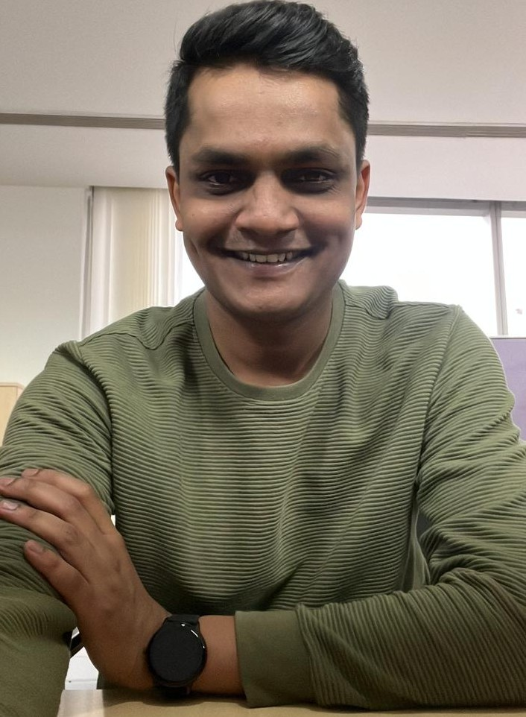
Customer Personal
GOOD PERSON
HELPFUL
Motivations
Photo
Goals
Bharath, a marketing head in Bangalore, tells that one must understand their car problems without wasting time during their busy schedule. He aims to fix issues efficiently with minimum cost and avoid unnecessary visits to mechanics.
Ethos
Frustrations
Bharath feel frustrated when he cannot understand what is wrong with his car. He get irritated due to time loss and unexpected breakdowns. He also have frustration from high repair costs and fear of being overcharged.
Age: 30
Occupation: Marketing Head
Location: Bangalore
Personality
Bio
Bharath is a working professional based in Bangalore, currently serving as a Marketing Head in IT company. He has a busy lifestyle with tight schedules and frequent travel, which makes time management very important for him. He prefers smart, efficient solutions that save time, reduce stress, and help him make quick and confident decisions in his daily life.
Notes:
Time: 7 mins
Get students to brainstorm on the customer persona and VPC

Slide 7

Value Proposition Canvas
Place your logo here
.
I would LOVE it if:
? What would make the customer happy?
They expect simple solutions, low cost, and easy access to nearby help when needed.
? What do the clients want when facing the problem?
Customers want a quick and accurate understanding of their car problem without confusion.
What do you offer that makes the customers happy?
Our solution provides quick and accurate diagnosis of car problems with simple and easy-to-understand guidance for users. It helps save time and reduce unnecessary repair costs by offering smart suggestions and solutions. The app is designed to be user-friendly, making it accessible even for beginners.
I would WANT:
What do the clients do (actions) when facing the problem?
Clients usually visit a mechanic or seek help from experienced people to identify the issue. They also search online or use basic apps and tools to find possible solutions.
GAIN CREATORS
FIT
GAINS
What is the product or service that you are offering?
We are offering an AI-powered mobile application that helps users diagnose and understand car problems easily. It allows users to input symptoms through text, images, or audio and provides accurate answer
PRODUCT/
SERVICE
JOBS
PAIN KILLERS
PAINS
Which features of your offering relieve the customer's pains?
AI-based quick problem diagnosis reduces confusion and saves time. Simple step-by-step guidance removes dependency on mechanics for small issues. Camera and audio analysis help identify problems easily. Garage locator and cost suggestions reduce stress and unnecessary expenses.
I would HATE it if:
What are the pains of the clients when facing the problem?
Clients feel confused and stressed because they don’t understand the car problem. They face time loss, high repair cost.

Slide 8

Solution
Place your logo here
Describe your Solution:
We offer An AI-powered mobile app that helps users quickly identify and understand car problems. It uses text, images, and audio to analyze issues and give simple solutions. The app guides users step-by-step and suggests nearby garages if needed. It is designed to be easy, fast, and helpful for everyone.
The details of our offering consist of:
1.Selection of vehicle company , name ,model and variant.
2. Virtual Mechanic Assistant with AI (search bar)
3. Image and Video based Diagnosis
4. AI sound analysis
4. Garage finder near the location.
5. Media access
6. Spare parts information and price checking
List the Benefits of Your solutions
1. Easy to use for everyone with AI
guidance
2. Saves money and time.
3. Quick help anytime.
4. Reduces stress and confusion.
Notes:
Evaluation Criteria for slides 8 and 9
Check the following on the correctness of VPC: a. Have you identified the correct pains & gains; pain relievers & gain creators (2 marks) b. Have you identified the correct Jobs-to-be-done? (1 mark) c. Are the pain relievers addressing the customer pains? (1 mark) d. Have you identified the right value proposition so that the solution makes the customer's life better? (1 mark)

Slide 9

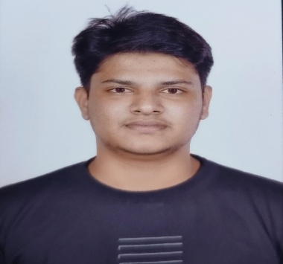

Team Composition
Place your logo here
Team member 1
Team member 2
Team member 3
What makes us a good team to solve the problem we chose?
Our team is strong because we combine technical knowledge,
creative thinking, and problem-solving skills to approach the
problem from multiple angles. With clearly defined roles like CEO,
Marketing Head, and CFO/CMO, we ensure efficient decision-making
and execution. We share a strong interest in Al and innovation, which
helps us build practical and modern solutions. Our communication,
collaboration, and willingness to learn make us adaptable and
focused on achieving results.
Picture
Picture
Picture
Role/Position:
CEO
Role/Position:
MARKET HEAD
Role/Position:
CFO/CMO
Key Strengths and abilities
Logical thinking skills
Interest in AI and innovation
Willingness to learn
Presentation skills
Key Strengths and abilities
Strong problem solving
Technical knowledge with AI
and innovation
Good communication skills
Creative thinking
Key Strengths and abilities
Technical knowledge
Communication skills
Confidence

Slide 10
Thank You!

